Slide 1
Depth Learning
Unsupervised Monocular Depth Learning in Dynamic Scenes
Li, Hanhan, et al. arXiv preprint arXiv:2010.16404 (2020).

Slide 2
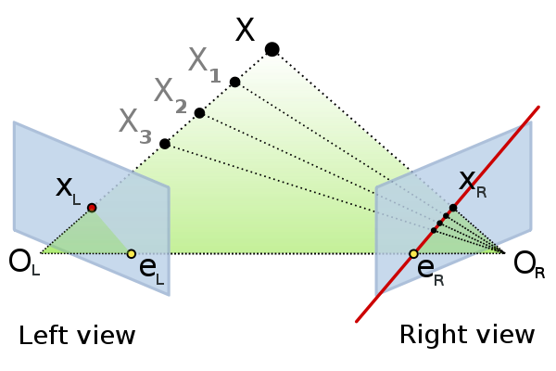
Unsupervised Monocular Depth Learning in Dynamic Scenes
Introduction
Estimating depth and object motion in 3D given a monocular video stream
일반적으로 사전 지식에 의존 – deep network가 제공 : 많은 양의 데이터 train으로 learn
Self-supervised learning of depth estimation (rely on monocular video itself for supervision)
Based on principles of SFM (structure from motion) : same scene, 2 different position
Rely on Additional cues
One source : Semantics
Auxiliary(보조) segmentation model : 비디오의 움직이는 물체들 segment 가능
다른 종류의 사전지식 활용
앞의 자동차 같은 속도 = 정적으로 보임
Godard et al. – 프레임간 변경되지 않은 부분 photometric consistency loss에서 exclude
한가지 특정 유형의 움직임으로 제한됨
Optical flow : leaned with depth, unsupervised
Stereo input 사용
Challenges
Texture less areas
Occlusions
Reflections
Moving objects
Notes:
Occlusions : 영상 폐색 영역. 가려지는 부분

Slide 3
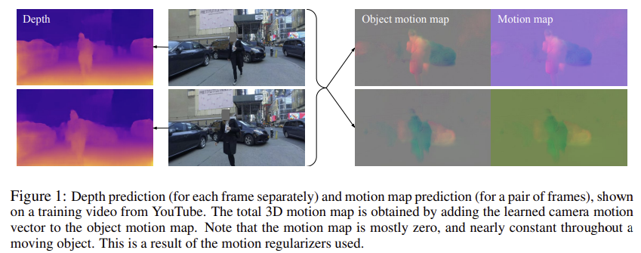
Unsupervised Monocular Depth Learning in Dynamic Scenes
Introduction
⇒ A method for learning jointly depth, ego-motion and a dense object motion map in 3D from monocular only
Novel regularization method for the residual translation fields (based on 1/2 norm)
Depth map
Deep network → a dense 3D translation field
Background translation : camera (ego-motion)
Object translation field
Significant amount of regularization
Regularizing sufficiently(충분히)
Preserving the ability of model 모델의 능력 보존
Nature of residual translation fields
They are sparse 희소하다 – 대부분 background / static 물체
Tend to be constant 일정하다 – rigid moving object in 3D space
Notes:
Regularization – 가중치 규제
regularization을 하는 것, 즉 W가 작아지도록 학습을 한다는 것의 의미는 local noise가 학습에 큰 영향을 끼치지 않는다는 것을 의미하며, outlier(특이점)의 영향을 적게 받도록 하고 싶은 것이다. 결과적으로 일반화에 적합한 특성을 갖게 만드는 것이라 볼 수 있다.
L1, L2 Regularization 차이
- L1 : L1은 통상적으로 상수 값을 빼주도록 되어 있기 때문에 특정 weight들은 0으로 수렴하게 돼서 몇 개의 중요한 가중치들만 남게 된다. 그러므로 몇 개의 의미 있는 값을 끄집어내고 싶은 경우에는 L1이 효과적이기 때문에 sparse model에 적합하다. 단 미분이 불가능한 점이 있기 때문에 gradient-based learning에 적용시에는 주의가 필요하다.
- L2 : L2는 outlier에 대해선 L1보다 덜 Robust(둔감)하다. 따라서 Outlier에 대해 신경을 써야하는 경우에 사용한다.

Slide 4
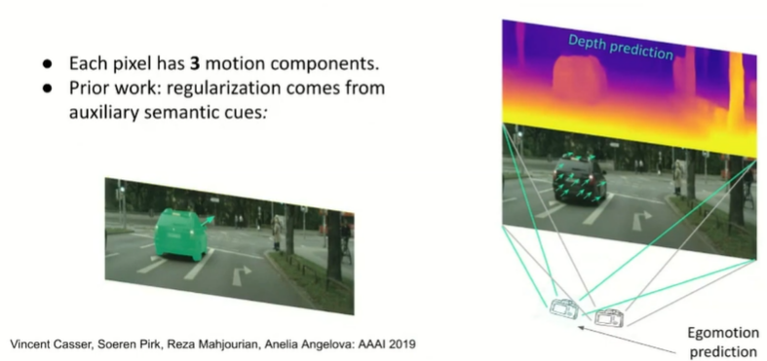
Unsupervised Monocular Depth Learning in Dynamic Scenes
Introduction
> Object map
https://www.youtube.com/watch?v=hHlU5G-ONwM

Slide 5
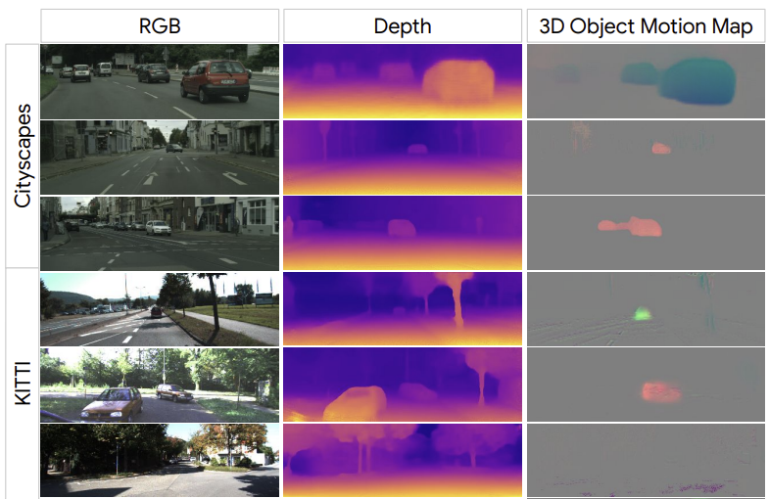
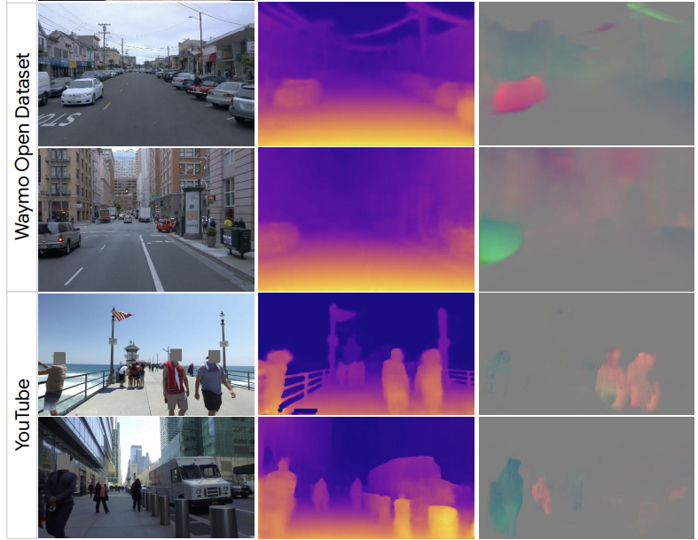
Unsupervised Monocular Depth Learning in Dynamic Scenes
Introduction
> Cityscapes, KITTI, Waymo, YouTube
> Qualitative results – depth & 3D object motion map
Not need to segment out objects (motion 추정위해)
Not assume stereo data
Directly regularizes motion in 3D → 정확도 향상

Slide 6
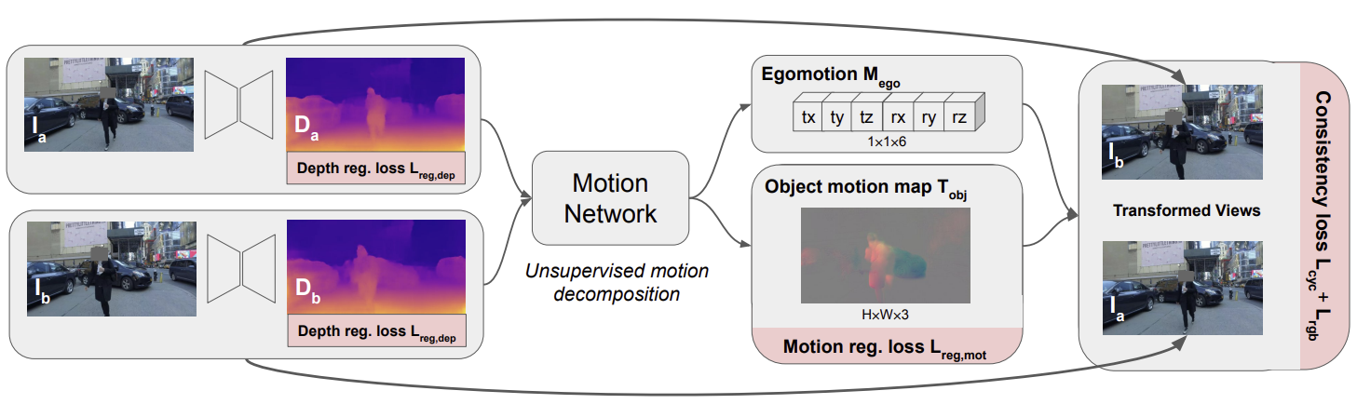
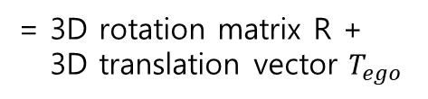
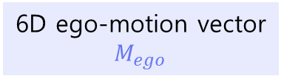
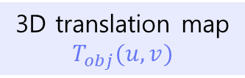
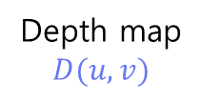

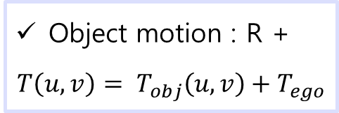
Unsupervised Monocular Depth Learning in Dynamic Scenes
Method
Adjacent video frames
$$I_{a}, I_{b}$$
+
Depth map
$$D(u,v)$$
6D ego-motion vector
$$M_{ego}$$
= 3D rotation matrix R +
3D translation vector $T_{ego}$
Depth network
Object motion : R +
$$T\left(u,v\right)= T_{obj}\left(u,v\right)+T_{ego}$$
3D translation map
$$T_{obj}(u,v)$$
Scene에 관련된 Object
카메라에 관련된 scene

Slide 7
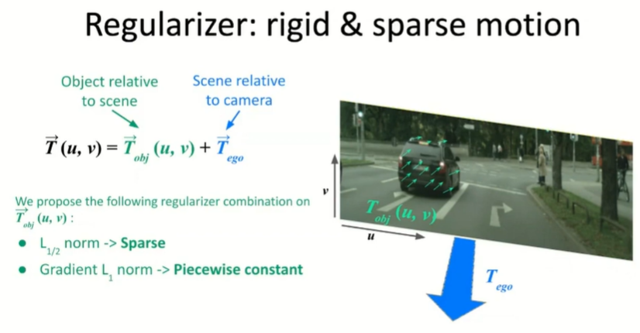
Unsupervised Monocular Depth Learning in Dynamic Scenes
Method
> Recognize object map without semantic cues
Sparse
Piecewise constant
# Piecewise constant
배경 = 0
물체 안에서는 constant
다른 물체 있으면 그 안에서도 constant
https://www.youtube.com/watch?v=hHlU5G-ONwM

Slide 8
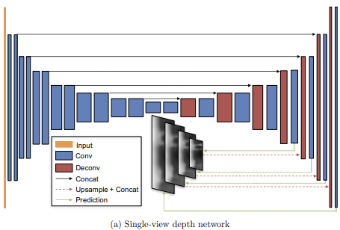
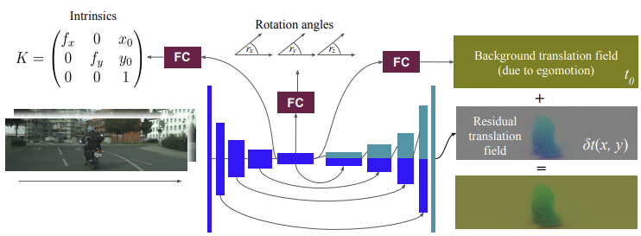
Unsupervised Monocular Depth Learning in Dynamic Scenes
Method
Depth and Motion Networks
Depth network
Encoder-decoder architecture
Motion network
Input : pair of consecutive frames 연속적인 프레임
4 channels = 3 RGB + predicted depth
Ref) Zhou, Tinghui, et al
“Unsupervised Learning of Depth and Ego-Motion from Video”
Ref) Gordon, Ariel, et al. "Depth from videos in the wild: Unsupervised monocular depth learning from unknown cameras."

Slide 9
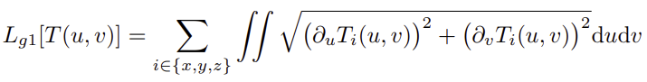
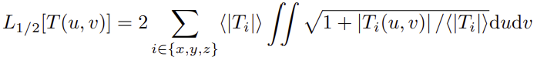

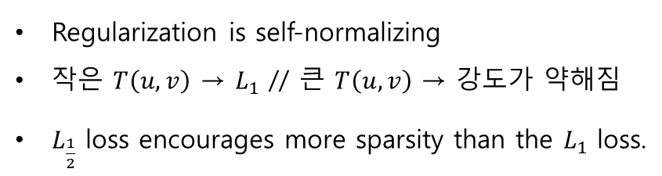
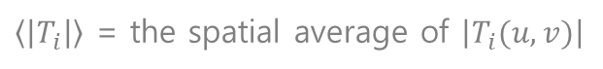
Unsupervised Monocular Depth Learning in Dynamic Scenes
Method
Losses
Motion Regularization
> Group smoothness loss
Moving area의 변화를 최소화
→ Moving object 전체에서 motion map이 일정하게 유지되도록 한다.
Moving objects가 rigid 일거라 예상하여 수행됨
> Sparsity loss
Regularization is self-normalizing
작은 $T\left(u,v\right)$ → $L_{1}$ // 큰 $T\left(u,v\right)$ → $강도가$ 약해짐
$L_{\frac{1}{2}}$ loss encourages more sparsity than the $L_{1}$ loss.
$\left\langle \left|T_{i}\right|\right\rangle$ = the spatial average of $\left|T_{i}(u,v)\right|$
Piecewise-constant $T_{obj}\left(u,v\right)$ : 물체가 배경에 대해 pure translation으로 움직이는 모든 장면을 표현할 수 있다
→ But rotating 회전 = residual translation field 일정하지 않음
→ 흔하지 않기 때문에 근사치가 적절할 것으로 기대
Notes:
The group smoothness loss Lg1 on T_obj(u, v) minimizes changes within the moving areas, encouraging the motion map to be nearly constant throughout a moving object. This is done in anticipation that moving objects are mostly rigid.

Slide 10
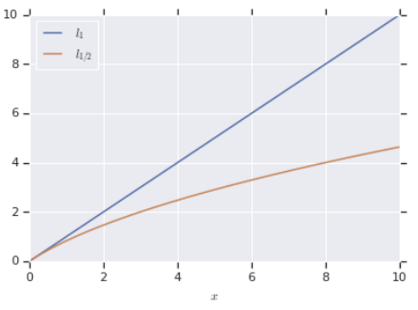

Unsupervised Monocular Depth Learning in Dynamic Scenes
Method
Losses
> Visualize the effect of the square root norm
-2 : offset (비교를 위해)
Notes:
The group smoothness loss Lg1 on T_obj(u, v) minimizes changes within the moving areas, encouraging the motion map to be nearly constant throughout a moving object. This is done in anticipation that moving objects are mostly rigid.

Slide 11
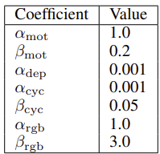



Unsupervised Monocular Depth Learning in Dynamic Scenes
Method
Losses
Depth Regularization
→ Standard edge-aware smoothness regularization on the disparity maps d(u, v)
→ 색 변화가 큰 픽셀에서는 regularization이 더 약함
> hyperparameters
Consistency Regularization
> Motion cycle consistency loss
→ encourages the forward and backward motion between any pair of frames to be the opposite of each other.
> Occlusion-aware photometric consistency loss
→ encourages photometric consistency of corresponding areas in the two input frames
→ L1 loss + SSIM structural similarity loss

Slide 12
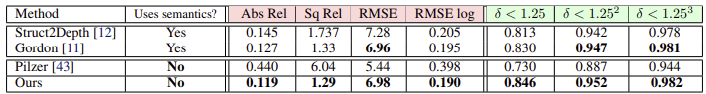
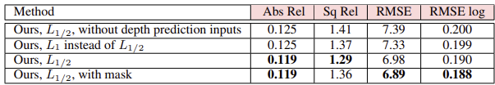
Unsupervised Monocular Depth Learning in Dynamic Scenes
Experiments
Cityscapes
Urban driving dataset - prevalence of dynamic scenes → challenging
> 모델 간 비교
depth cutoff is 80m
416×128
input, output
RMSE 제외하고 outperform
> Ablation study on Cityscapes
→ L1 사용하면 ‘Abs Rel’ 0.006 증가
→ mask 사용해도 no improvement
mask : pretrained segmentation model 사용
(COCO dataset)

Slide 13
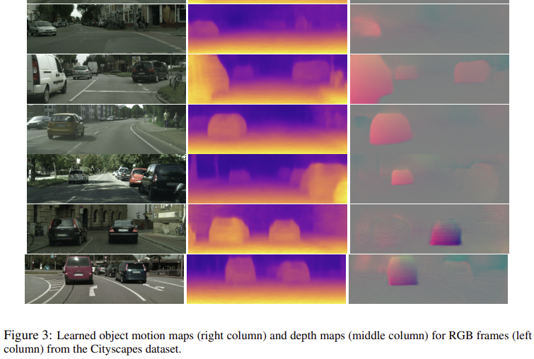
Unsupervised Monocular Depth Learning in Dynamic Scenes
Experiments
Cityscapes

Slide 14
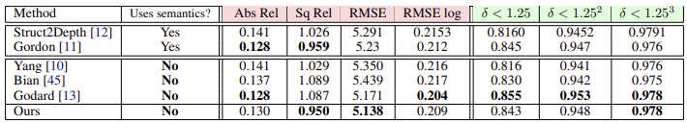
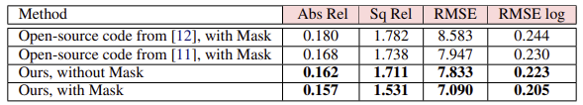
Unsupervised Monocular Depth Learning in Dynamic Scenes
Experiments
KITTI
Urban environments – benchmark for depth and ego-motion estimation로 유명함
Evaluation = + LiDAR data
A small number of dynamic scenes
depth cutoff is 80m
416×128
input, output
Waymo Open Dataset
Dynamic scenes + nighttime driving + diverse weather condition
Evaluation – ground truth depth of LiDAR

Slide 15
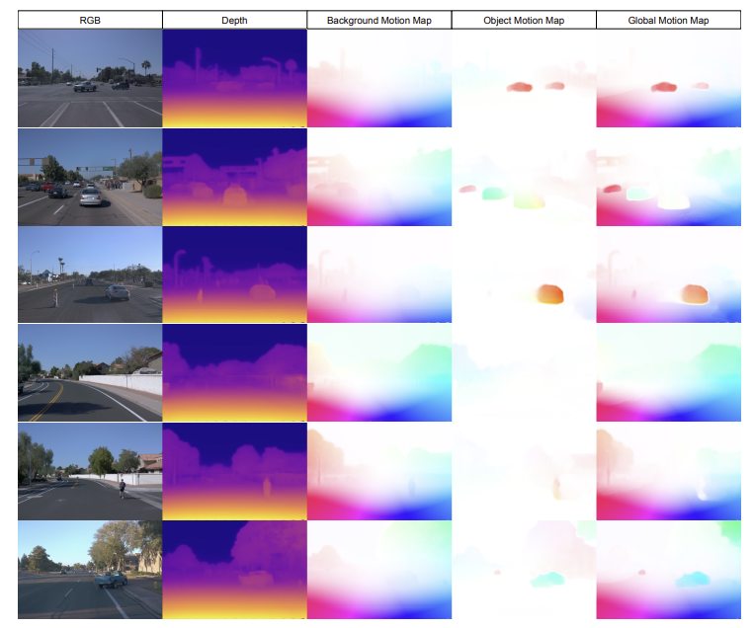
Unsupervised Monocular Depth Learning in Dynamic Scenes
Experiments
Waymo Open Dataset
This figure shows RGB images, depth maps, and the 2D-appearance flows projected from 3D motion maps on the Waymo Open Dataset.
Here, we colorize based on flow direction with intensity corresponding to flow magnitude.
Using our depth and background motion estimate, we can derive 2D appearance flow of static parts of the scene (middle).
We can use the same procedure to visualize our object motion field and their global composite (right), respectively.

Slide 16
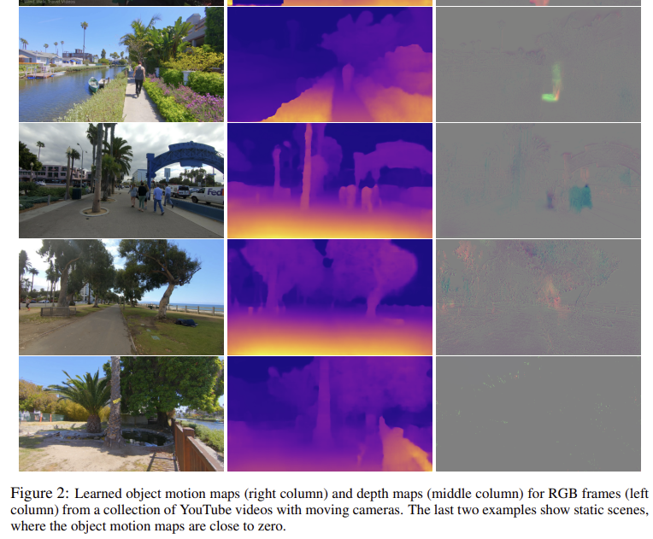
Unsupervised Monocular Depth Learning in Dynamic Scenes
Experiments
YouTube videos
Hand-held monocular cameras by 다양한 환경에서 걷는 사람들
Camera intrinsics 모름
동시에 learn
4 trainable variables
2 focal lengths
2 optical centers
→ static scenes
→ static scenes

Slide 17
Unsupervised Monocular Depth Learning in Dynamic Scenes
Conclusion
A novel unsupervised method for depth learning in highly dynamic scenes 동적인 장면들 depth 추정
Jointly solves for 3D motion maps and depth maps
Train – unlabeled monocular videos without requiring any auxiliary semantic information 보조 정보 없이
Use end-to-end differentiable losses - method is simple
Encourage photometric consistency, motion smoothness, motion sparsity
Limitation
Object rotation and deformation is not explicitly handled 물체 회전, 변형이 명확하게 처리되지 않음
Camera movement needs to be present to receive learning signals 카메라 움직임이 있어야 함

